Slide 1

Cross Platform Mobile and Web Apps Development
Day 3

Slide 2
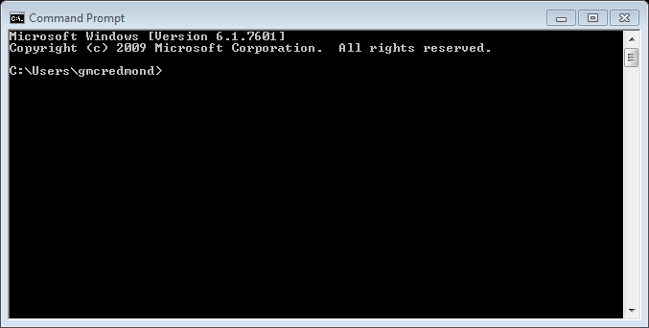
Working with Command Line (Windows)
The Command Prompt program allows you to work in an environment that looks more like a traditional operating system as opposed to the icon based Windows environment. In Command Prompt, you will use your keyboard. You won't use your mouse at all. Command Prompt works at a lower level than Windows. This means that you will have more control over the machine. The disadvantage is that it is less user-friendly.

Slide 3
Working with Command Line (Windows)
To launch Command Prompt select Start and type cmd in the search box. (Or use “run” on older versions of Windows.)
The Command Prompt shows up as a black terminal window. The command prompt should look something like: C:\>
This is where you type commands. Windows does not care if you use upper or lower case. That means that command cd is the same as CD. It also means that, in Windows, the file HelloWorld.java is the same as helloworld.java.

Slide 4
Working with Files and Directories
dir: To view the contents of a directory, type dir. This command will list all the files and directories within the current directory. It is analogous to clicking on a Windows folder to see what's inside.
mkdir: To create a new directory, use the command mkdir. The following command creates a directory named hello: C:\> mkdir hello To see that it actually worked, use the dir command.

Slide 5
Working with Files and Directories
cd: It is frequently useful to know in which directory you are currently working. In order to find out, type cd at the command prompt. C:\> cd C:\
To change directories, use the cd command with the name of a directory. C:\> cd hello
Now, the command prompt will be: C:\hello>

Slide 6
Working with Files and Directories
echo>: You can create a new file in the current directory by using the echo> command. (In a mac / linux environment, this is the equivalent of the “touch” command). echo> index.html
Be sure to include the file’s extension so that the correct file type can be created using this command.
You can create multiple new files by adding a space between each filename/extentsion. echo> index.html style.css web.pptx

Slide 7
Working with Files and Directories
del: delete a file from the current directory by using the delete command del followed by the filename that you wish to delete. (Directories are deleted with a different command.) C:\> del hello.txt
When deleting a file , you have to enter the full file name including the file extension.

Slide 8
Working with Files and Directories
rmdir: delete a directory from the current parent directory. C:\> rmdir hello If the directory you are trying to run the rmdir command on is NOT EMPTY, you can add the /s option to delete all of the files that it contains (formerly the DELTREE command) C:\> rmdir /s hello

Slide 9
Working with Files and Directories
move: cuts a folder from its current location and places it in a new folder C:\> move hello.txt newfolder

Slide 10
Additional Commands
cls: clears the command line screen leaving you with a new prompt at the top (keeps you in current directory).
start: can open a program from the command prompt. C:\> start notepad++
You can also use the command line to open the windows explorer window at the current directory C:\> start .

Slide 11
Native Mobile Apps
Apple devices are programmed in Objective-C using an integrated development environment (IDE) called Xcode.
Android devices are programmed in Java (using a number of different IDEs, including Eclipse and Android Studio).
Microsoft Windows needs Visual Studio, .Net, and any of the supported languages including C#.
Apache Cordova is an open-source mobile development framework. It allows you to use standard web technologies - HTML5, CSS3, and JavaScript for cross-platform development. Applications execute within wrappers targeted to each platform, and rely on standards-compliant API bindings to access each device's capabilities such as sensors, data, network status, etc.

Slide 12
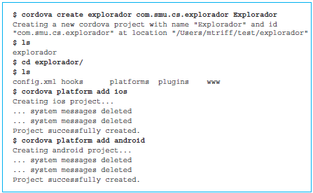
Cordova setup
Install Cordova following the instructions from http://cordova.apache.org/#getstarted
Launch the Terminal window on the Apple computer or Command Line window on Windows to get to the command line interface.
Command line session that begins the process of creating the native versions of the Explorador app for iOS and Android:

Slide 13
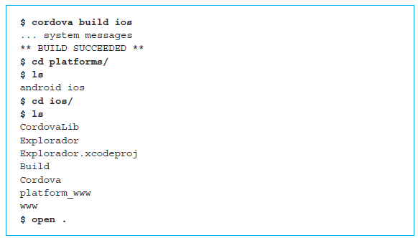
Building an iOS app
Commands specific to building the iOS app are shown below:

Slide 14
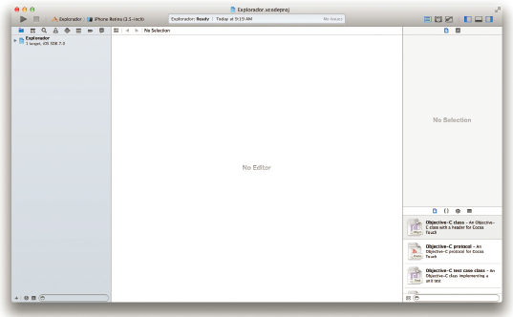
iOS app in XCode IDE

Slide 15
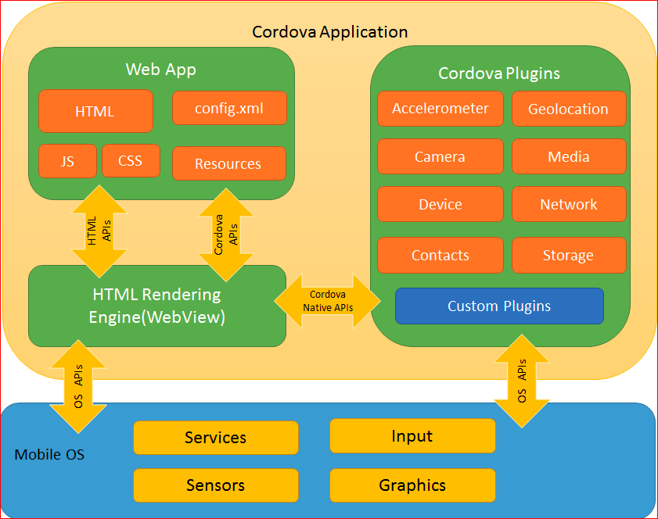
Cordova Architecture
http://cordova.apache.org/docs/en/latest/guide/overview/

Slide 16
Cordova Architecture
Web View
The Cordova-enabled WebView may provide the application with its entire user interface.
Web App
This is the part where your application code resides. The application itself is implemented as a web page, by default a local file named index.html, that references CSS, JavaScript, images, media files, or other resources are necessary for it to run. The app executes in a WebView within the native application wrapper, which you distribute to app stores.
This container has a very crucial file - config.xml file that provides information about the app and specifies parameters affecting how it works, such as whether it responds to orientation shifts.
Plugins
Plugins are an integral part of the cordova ecosystem. They provide an interface for Cordova and native components to communicate with each other and bindings to standard device APIs. This enables you to invoke native code from JavaScript.
Apache Cordova project maintains a set of plugins called the Core Plugins. These core plugins provide your application to access device capabilities such as battery, camera, contacts, etc.
In addition to the core plugins, there are several third-party plugins which provide additional bindings to features not necessarily available on all platforms. You can search for Cordova plugins using plugin search or npm. You can also develop your own plugins. Plugins may be necessary, for example, to communicate between Cordova and custom native components.
http://cordova.apache.org/docs/en/latest/guide/overview/

Slide 17
Exercise
Create your first Cordova Android app following the instructions at http://cordova.apache.org/docs/en/latest/guide/cli/index.html
Make sure you open the Windows command line as administrator
Make sure you have the latest Java JDK installed

Slide 18
Local Storage of Data
Typically, application data is stored (persisted) on the Server. You will learn about databases in the next course (WA150). Sometimes, however, it makes more sense to store data on the Client.
Why Store Data on the Client?
The main reason is practicality. JavaScript code running on the browser does not necessarily need to send all information to the server. There are several use cases:
You want to increase performance. You can cache data client-side so it can be retrieved without additional server requests.
You have a significant quantity of client-side-only data, e.g. HTML strings or widget configuration settings.
You want you make your application work off-line.
https://www.sitepoint.com/html5-browser-storage-past-present-future/

Slide 19
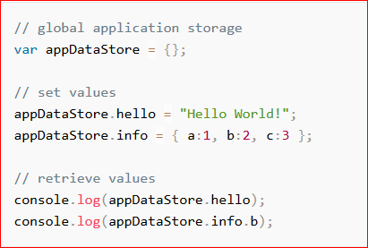
JavaScript Variables
The simplest choice is JavaScript variables. It may be practical to create a single global variable to store application data.
It’s also possible to store values in the page DOM as node attributes or properties. This can be useful for widget-specific values, but it’s slower and riskier than JavaScript variables; future browsers or other libraries may interpret your data in unexpected ways.
The advantages of JavaScript variables:
the fastest and simplest solution
no need to serialize or de-serialize data
ideal for single-page applications
The disadvantages:
very fragile — linking elsewhere, refreshing or closing the tab will wipe all data
global variables can be overwritten and analyzed by third-party scripts.
https://www.sitepoint.com/html5-browser-storage-past-present-future/

Slide 20
Cookies
Cookies are domain-specific chunks of text data. They sound tasty, but cookie handling is awkward in JavaScript since the basic document.cookie string must be parsed
The advantages of cookies:
a reliable method of retaining state between the client and server
by setting an expiry date, cookie data will persist beyond page refreshes and tab closing
cookies are supported in all modern browsers
The disadvantages:
clunky JavaScript implementation — you will need a cookie-handling library
values are strings only — other data must be serialized using methods such as JSON.stringify and JSON.parse
cookie storage space is limited — do not depend on having more than 20 cookies of 4KB each
cookies can be deleted or blocked
cookies were unfairly labeled as a threat to internet privacy; you may need to comply with bizarre regional rules and regulations.
The flip-side of cookie client/server sharing causes the biggest technical issue. Cookie data is sent in the HTTP header of every request and response. It’s therefore appended to every HTML page, image, CSS file, JavaScript file, Ajax call, etc. If you had 50Kb of cookie data and downloaded ten 1KB images, it would result in one megabyte of additional network traffic.
https://www.sitepoint.com/html5-browser-storage-past-present-future/

Slide 21

window.name
The window.name property is a little odd. You can set a single string value which persists between browser refreshes or linking elsewhere and clicking back.
The advantages of window.name:
simple to use
data is retained on the client only and never sent to the server
the property permits several megabytes of information
wide browser support
The disadvantages:
data is lost when the tab or browser is closed
only a single string value can be stored — serialization will be necessary
pages in other domains can read or change window.name data — never use it for sensitive information
window.name was never designed for data storage. It’s a hack and vendors could drop support at any time. For that reason, it’s best to use alternative storage options.
https://www.sitepoint.com/html5-browser-storage-past-present-future/

Slide 22
Web SQL Database
The Web SQL Database (http://www.w3.org/TR/webdatabase/) was an initial attempt by vendors to bring SQL-based relational databases to the browser. It has been implemented in Chrome, Safari and Opera 15+, but was opposed by Mozilla and Microsoft in favor of IndexedDB.
The advantages of Web SQL Database:
designed for robust client-side data storage and access
it uses SQL like many server side applications
some support on Webkit/Blink desktop and mobile browsers
The disadvantages:
SQL never seemed appropriate for client-side development
the database schema must be defined up-front
marginal browser support and the Webkit/Blink teams may eventually drop it
the W3C specification was abandoned in 2010
https://www.sitepoint.com/html5-browser-storage-past-present-future/

Slide 23
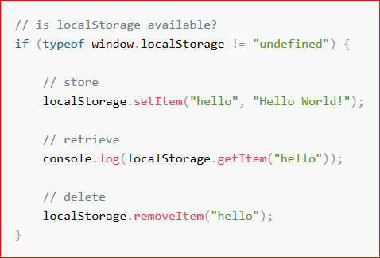
Web (Local) Storage
Web Storage provides two objects with identical APIs: window.localStorage to retain persistent data and code.sessionStorage to retain session-only data which is lost when the tab is closed. Domain-specific strings are stored using name/value pairs. Unlike cookies, the storage limit is far larger (at least 5MB) and information is never transferred to the server.
The advantages of Web Storage:
easy to use with simple name/value pairs
session and persistent storage options are available
an event model is available to keep other tabs and windows synchronized
wide support on desktop and mobile browsers including IE8+
Web Storage polyfills are available for older browsers which fall-back to cookie and windows.name storage methods
The disadvantages:
string values only — serialization may be necessary
unstructured data with no transactions, indexing or searching facilties
may exhibit poor performance on large datasets
https://www.sitepoint.com/html5-browser-storage-past-present-future/

Slide 24
IndexedDB
IndexedDB (http://www.w3.org/TR/IndexedDB/) provides a structured, transactional, high-performance NoSQL-like data store with a synchronous and asynchronous API. The API permits you to create databases, data stores and indexes, handle revisions, populate data using transactions, run non-blocking queries, and traverse data sets using cursors.
The advantages of IndexedDB:
designed for robust client-side data storage and access
good support in modern desktop browsers: IE10+, Firefox 23+, Chrome 28+ and Opera 16+
The disadvantages:
the API is very new and subject to revision
little support in older and mobile browsers
a large and complex API — it would be difficult and largely impractical to create a IndexedDB polyfill
like any NoSQL store, data is unstructured which can lead to integrity issues
https://www.sitepoint.com/html5-browser-storage-past-present-future/

Slide 25
HTML5 File API
The HTML5 File API is being extended to support writing as well as reading sequential data on the local file system. Your domain is provided with a complete sand-boxed hierarchical file system to use as it chooses.
The advantages of the HTML5 File API:
large text and binary files can be created and stored
performance should be good
The disadvantages:
a very early specification which is subject to revision
an obvious security risk unless file writing is restricted
little support in current browsers and polyfills may be impractical
unstructured data with no transactions, indexing or searching facilties
https://www.sitepoint.com/html5-browser-storage-past-present-future/

Slide 26
Summary
JavaScript variables will always be necessary but only use them for volatile in-memory data. Avoid DOM attributes/properties when possible.
Assuming it’s necessary, use cookies for retaining state between the client and server. But keep cookies small; a single token with a few characters should be enough.
Use HTML5 Web Storage to store data off-line or when large volumes of client-side-only information is required.
Keep an eye on IndexedDB; it will eventually become a viable storage mechanism when legacy browsers die out.
Similarly, the File API will become increasingly practical for storing unstructured data. It’s possibly the best solution for generated binary data such as images, audio, video and PDFs.

Slide 27
Exercise
In preparation for the extensive Cordova exercise tomorrow, review and start implementing the Cordova tutorial at http://ccoenraets.github.io/cordova-tutorial/index.html
Create the Cordova Project
Build a Cordova Project
Set up the Workshop Files
Choose a Data Storage Strategy

